Slide 1
San Francisco ONE System
Agency Lead Meeting
September 28, 2020

Slide 2
TODAY’S AGENDA
Welcome
Introduce Andrea
Housing Standardization
Virtual ROI
Problem Solving
Multiple Queues
LSA
Other topics (time permitting)

Slide 3

Welcome Andrea
Andrea Bañas
Deputy Project Administrator

Slide 4


Housing Standardization

Slide 5
Housing Standardization
The Department of Homelessness & Supportive Housing is working to onboard all housing providers to the ONE System.
Supportive housing programs will be set up as separate ONE System programs for each subsidy source that has unique eligibility requirements.
Through this process, we will be reconfiguring some existing housing programs in ONE, and setting up housing programs that have not previously been tracked in the ONE System.
  HSH and Bitfocus will communicate with each agency prior to making any changes to your existing ONE System programs.

Slide 6
Housing Standardization
For the month of October, we will be piloting this work with a couple of providers.
Following the pilot phase, we plan to onboard providers one group at a time.
We will be sure to communicate out the timeline and status update as it becomes available.
We will ask each agency to identify the users who will perform essential functions in the ONE System, and provide new user and/or refresher training for those users.
  Training timelines- to be determined

Slide 7
Virtual ROI

Slide 8
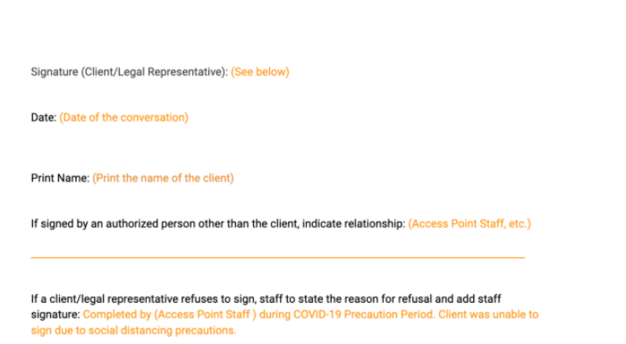
Virtual ROI
Providers must follow two modified requirements in order to uphold client privacy while working remotely with new clients. They can:
Give verbal notice to the client via Release of Information documents
NOTE: The COVID-19 Release of Information Process requires the client give meaningful verbal consent. Staff are required to review the content of the Releases of Information with the individual and offer to provide a written copy.
OR
Upload the Release of Information in ONE, note on the document that verbal consent was obtained, but could not be signed due to COVID-19 distancing measures.

Slide 9
Problem Solving

Slide 10
Problem Solving
Housing Problem Solving is both a practice and a system-wide intervention that works with a household experiencing homelessness to identify solutions to resolve their housing crisis outside of the Homeless Response System.
To date, Problem Solving has been captured outside of ONE using spreadsheets.
  The Department of Homelessness and Supportive Housing (HSH) and Bitfocus have been working to integrate the Problem Solving workflow into the ONE System.
Problem Solving will be captured using a combination of a screening and services.

Slide 11
Problem Solving Training
Training on the new workflow is expected to occur in mid-October.
All staff who provide Problem Solving to households will be notified when training dates are confirmed.

Slide 12
Multiple Queues

Slide 13
Multiple Community Queues
A key element of Coordinated Entry is the Community Queue.
  Households who have Housing Referral Status and are waiting to be referred to a resource.
Recent enhancement to Clarity Human Services included the ability for communities to have more than one Community Queue.
Community Queues may be used to manage both the Coordinated Entry process as well as referrals to other, non-housing related programs.

Slide 14
Multiple Queues
Previously One queue for all referral sources | Current Iteration Households can be placed on up to 5 queues at once Each queue is completely separate from one another Example: A community may have one queue for emergency shelter beds and another for permanent housing units.

Slide 15
Multiple Community Queues
Training on this new workflow is expected to occur in mid-October.
All staff who will be using the Community Queues as part of their workflow will be notified when training dates are confirmed.

Slide 16
LSA

Slide 17
BACKGROUND: LSA
AHAR: Annual Homeless Assessment Report
A national level report that provides information about homeless service providers and the populations they serve.
Three components:
  HIC - Housing Inventory Count
  PIT - Point in Time Count
  LSA - Longitudinal System Analysis
LSA: Longitudinal System Analysis
One of three components that make up the AHAR
Includes information about people and households experiencing homelessness

Slide 18
BACKGROUND: LSA
Three distinct follow-up periods
Two years prior
One year Prior
First 6 months of reporting period
Follow-up information
System use prior to client’s exit
Destination
Where applicable, lengths of time between re-engagement or return to homelessness
The LSA Journey:
CoC → HUD → Congress

Slide 19
LSA
We may be doing some targeted outreach over the next couple months to ask agencies to fix some data quality issues
(i.e abandoned enrollments, kids being enrolled without a HOH, etc.)
What you can do to prepare:
Please respond promptly to outreach emails from System Administration Team and your Agency HMIS Lead
Ensure all enrollments and exits have been entered
Review bed/unit utilization to ensure that it is between 90%-105%
Review data quality for each project type, paying special attention to:
HoH designation and family/group enrollments (any kids enrolled by themselves?)
Duplicate or erroneous enrollments (ask the Helpdesk to delete!)
Missing data/no exit interview (high missing rates cause errors in reporting process)

Slide 20
LSA
Key Reports to Manage and Review Data
There are a number of reports in the Clarity Human Service Report Library to help you manage your program and client data. In preparation for the LSA, please run these reports with date range of Oct 1 - Sept 30.
Click on the links for more details on what each of these reports provides:
[HUDX-225] HMIS Data Quality Report: what’s missing?
[GNRL-106] Program Roster: who’s enrolled by themselves vs. in group?
[GNRL-220] Program Details Report: what data has been entered?
[EXIT-101] Potential Exits: who’s inactive and could be exited?

Slide 21
Helpful Resources
ONESF Help Center Website
https://onesf.clarityhs.help
Bitfocus Helpdesk
onesf@bitfocus.com
415.429.4211

Slide 22


Thank You From Your SF Team!
Ja Eun Guerrero Huh, LCSW
Senior Project Administrator
Andrea Bañas
Deputy Project
Administrator
Sara Hoffman
Project Manager

