Slide 1

SFHOT - Street Outreach (Non PATH) Refresher Training
San Francisco ONE System

Slide 2
Logging into the Training Site
URL: onesf-train.clarityhs.com
Username:Train#
  # = the number assigned during the count off
Password: GoGi@nt5

Slide 3
Agenda
Welcome
Name, pronoun, one word for what home means for you
SFHOT Overview
Log into ONE System training site
SFHOT Data Collection Points
ONE System workflow
  Search for Client/Create Household
  Verifying unsheltered (Families Only)
  Location Tab
  Program Enrollment
  Record Outreach Services
  History Tab
  Exit

Slide 4
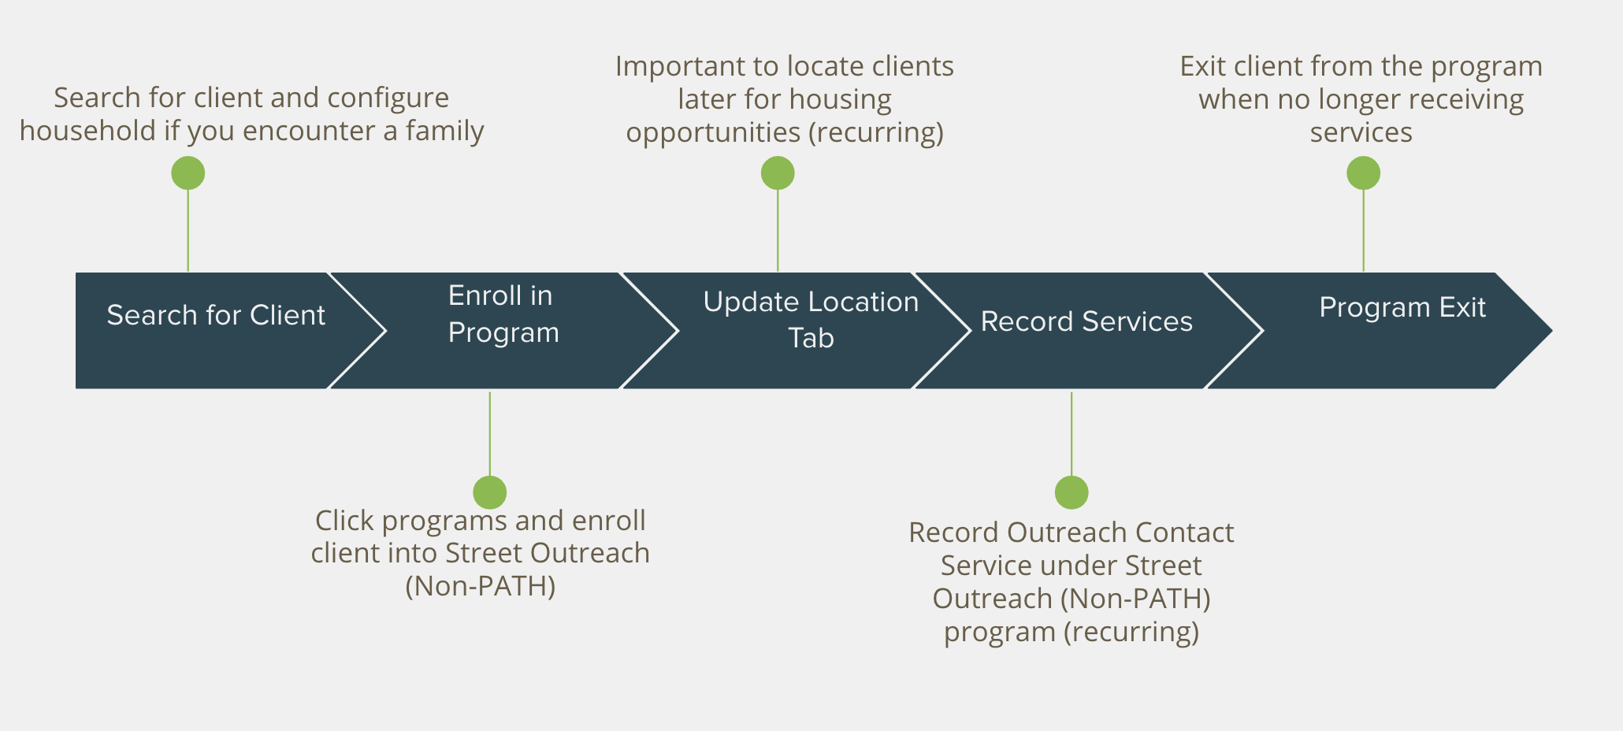
Overview of Street Outreach Process
Notes:
Record outreach contact services- new

Slide 5
SFHOT Data Collection
PROFILE SCREEN
Quality/Social Security Number
Quality/Name
Quality/Date of Birth
Alias
Gender
Pronoun
Sexual Orientation
Race
Ethnicity
Veteran Status
LOCATION TAB
Address Type
Name
Address 1
Address 2
City
State
Zip Code
Email
Phone 1
Phone 2
ENROLLMENT SCREEN
Program Entry Date
Housing Status at Entry
Living Situation
Lifetime length of homelessness in SF
Lifetime Length of Homelessness outside of SF
Disabling Conditions & Barriers
Cash Income for Individual
Non Cash Benefits
Health Insurance

Slide 6
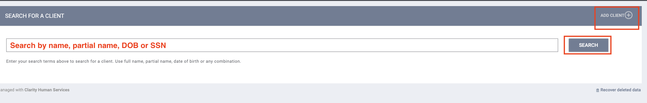
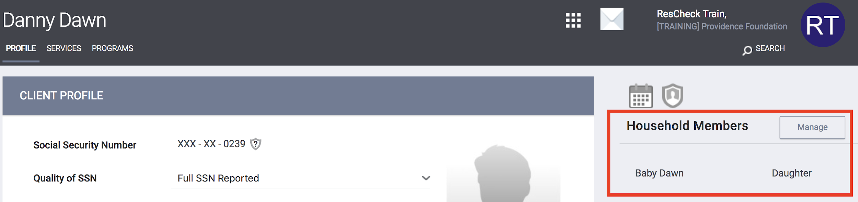
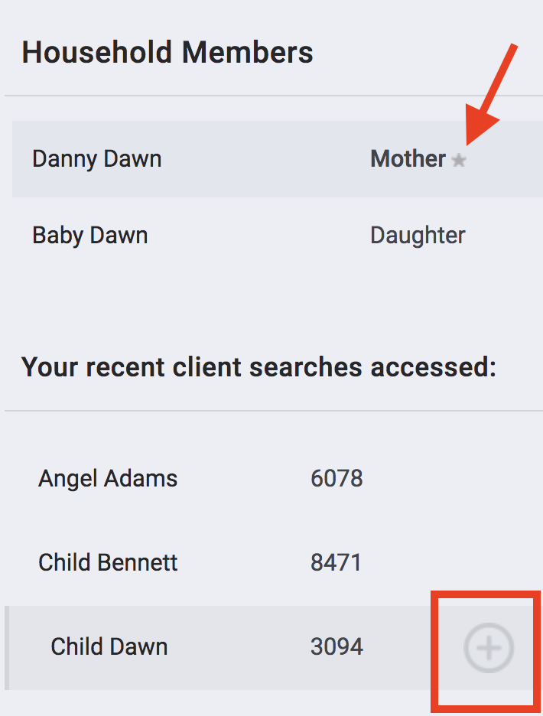
Search for Client/Create Profile/Family
Search for client/ head of household
  Search by name, DOB and SSN
If unable to find head of household, Create a new profile
Search/add any additional family members
*Please be careful not to create a duplicate profile!

Slide 7
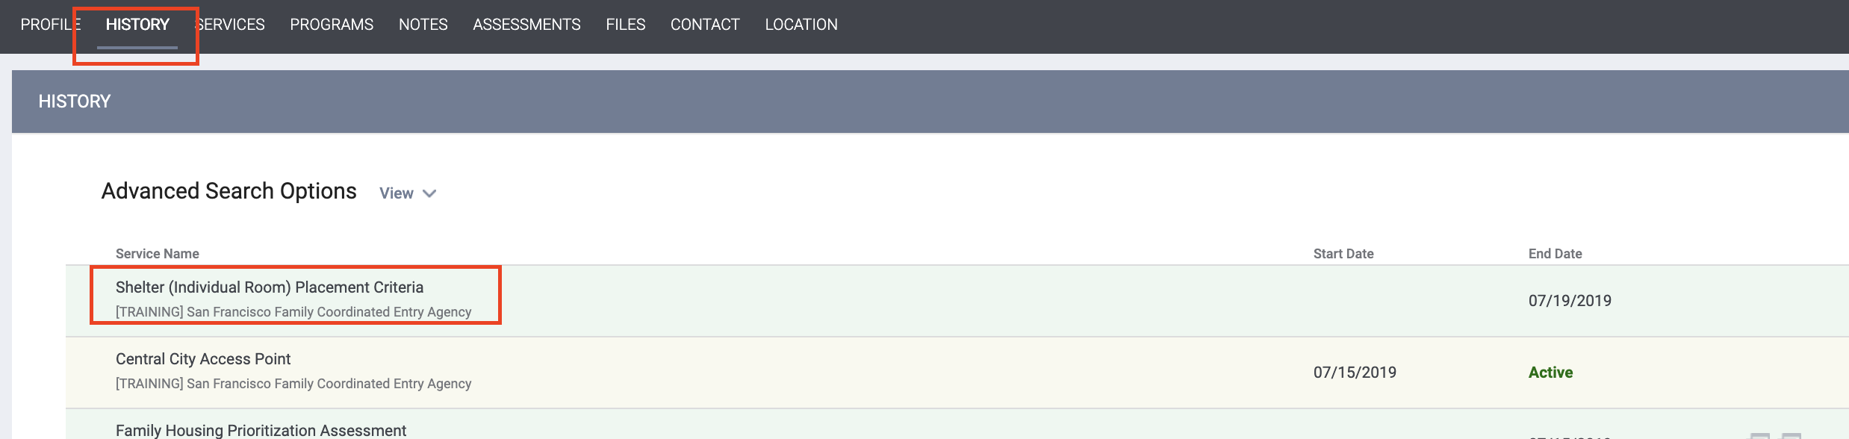
Complete/Update Shelter (Individual Room) Placement Assessment (FAMILIES ONLY)
If the family already had a record in ONE, check to see if the Shelter (Individual Room) Placement Assessment has been completed
  Click History
  Look for the Shelter (Individual Room) Placement Assessment

Slide 8
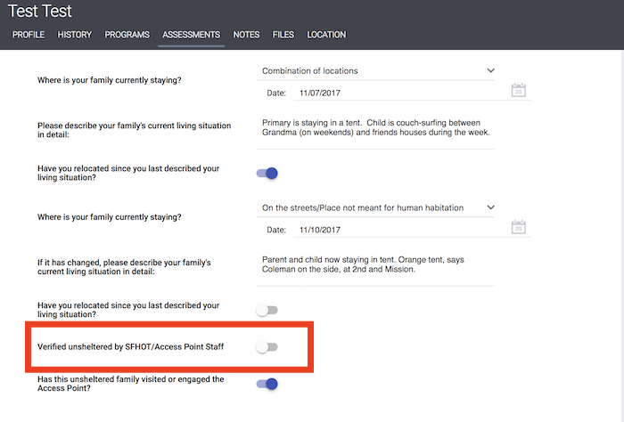
Update Shelter (Individual Room) Placement Assessment (FAMILIES ONLY)
If the assessment has been done and you have verified the family to be unsheltered, turn on the toggle for the question “Has this family been verified unsheltered by SFHOT or Access Point Outreach Teams”?

Slide 9
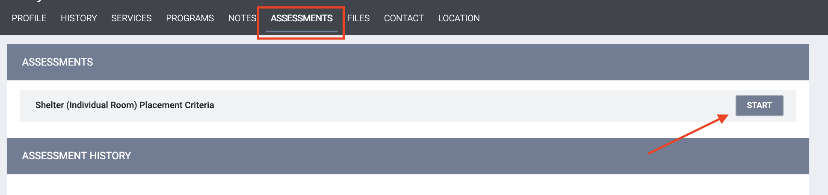
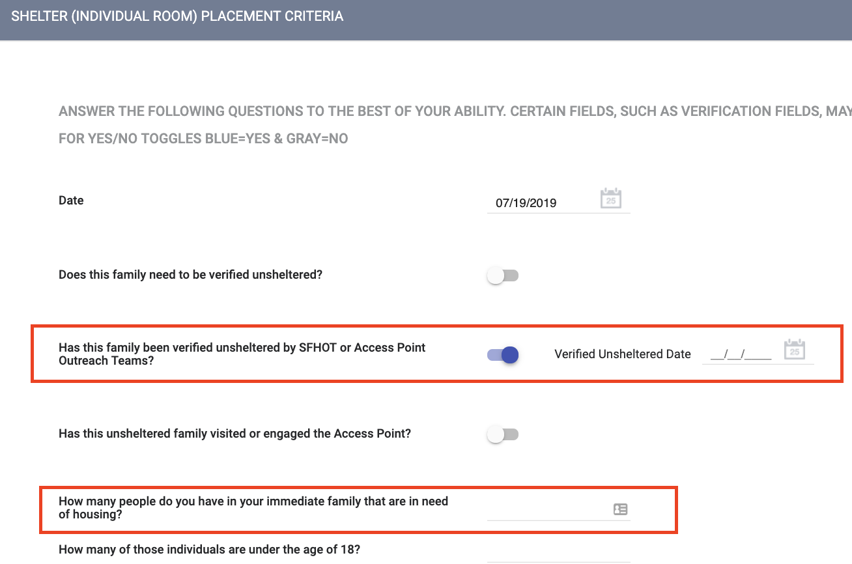
Complete Shelter (Individual Room) Placement Assessment (FAMILIES ONLY)
If the Shelter Placement Assessment has not been done, you will need to complete one for the family.
Go to the Assessment Tab
Click “start” for the Shelter (Individual Room) Placement Assessment
Answer the following questions:
  “Has this family been verified unsheltered by SFHOT or Access Point Outreach Teams”?- If yes, turn the toggle on so it is blue.
    Enter the verified date.
  “How many people do you have in your immediate family that are in need of shelter?”

Slide 10
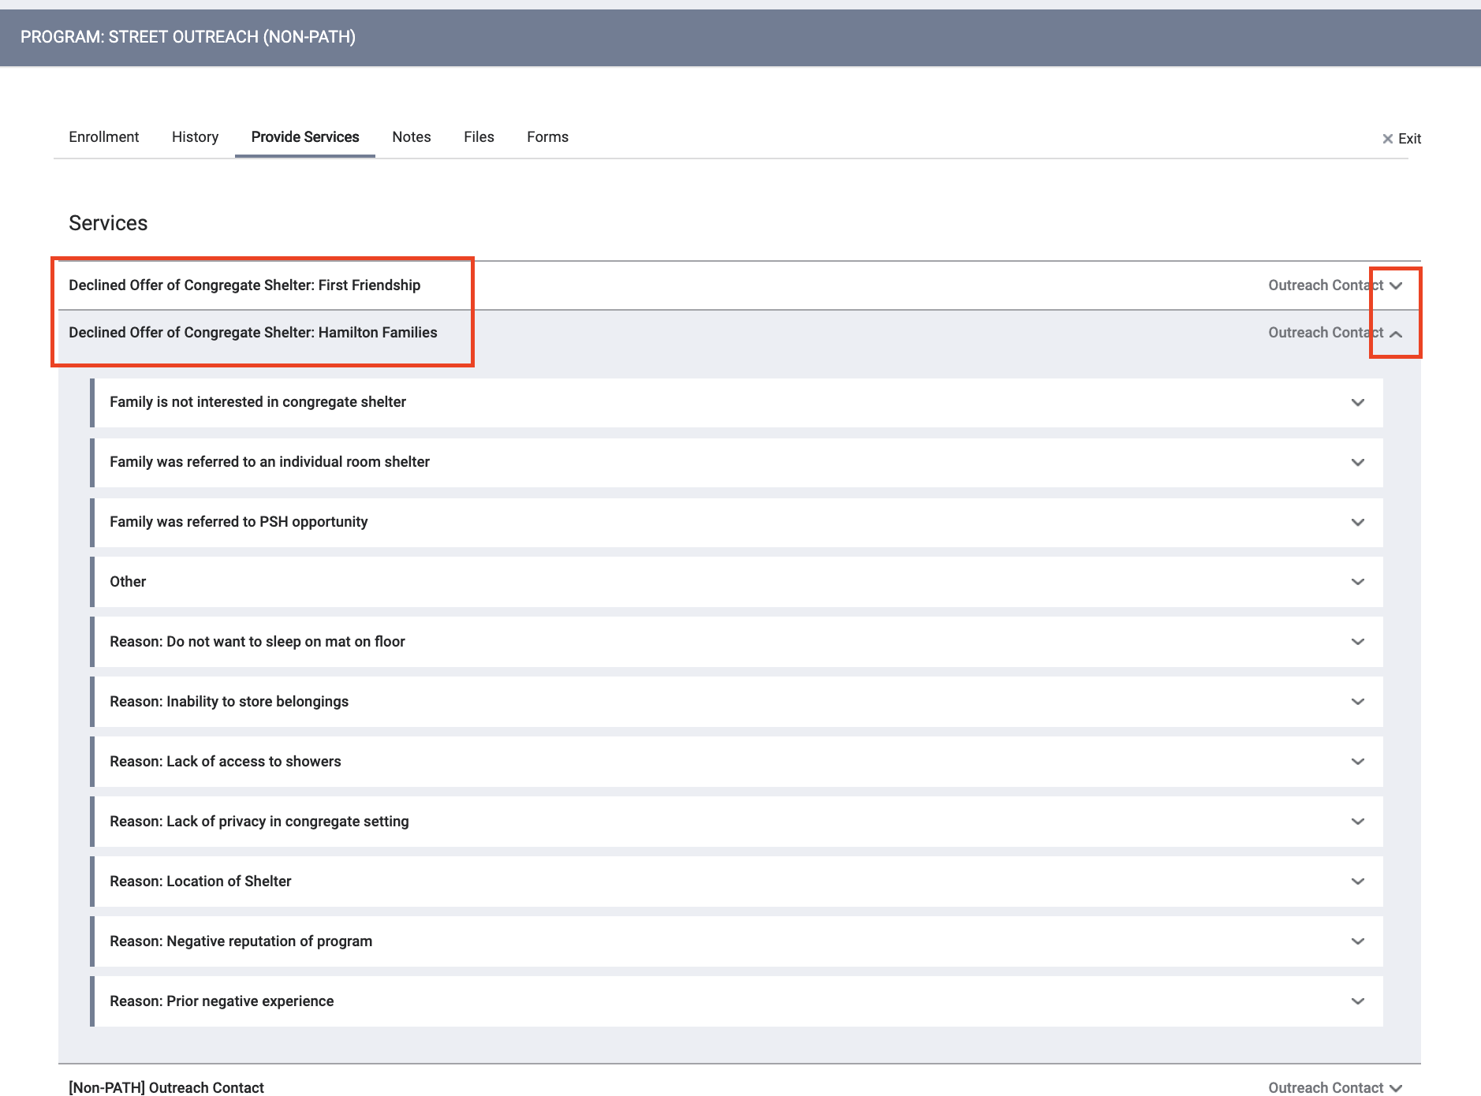
Declined Offer of Congregate Shelter
If a family declines congregate shelter, you should record this as a service
From the dropdown items, select the response that best matches the client’s reason for refusal

Slide 11
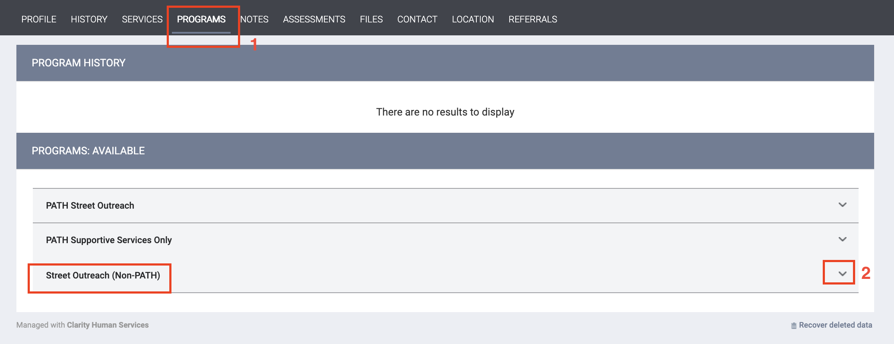
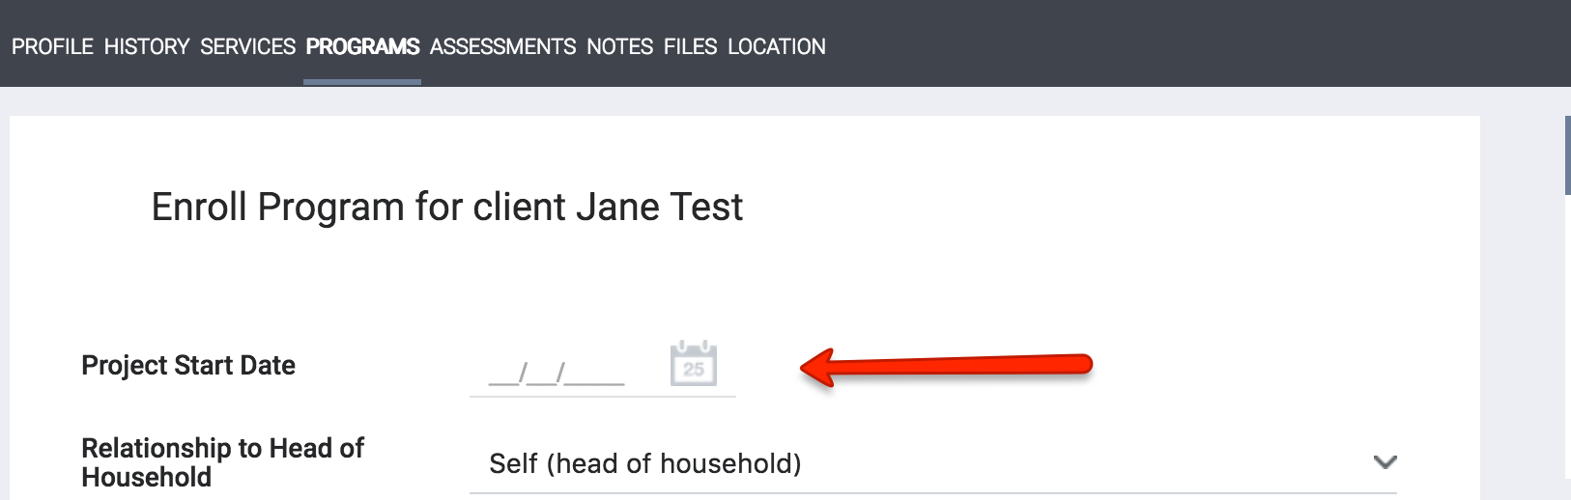
Enroll in Street Outreach (Non-PATH)
Click on Programs Tab
Click the drop down to the right of the Street Outreach Non-PATH program
Project Start Date is first date of Contact

Slide 12
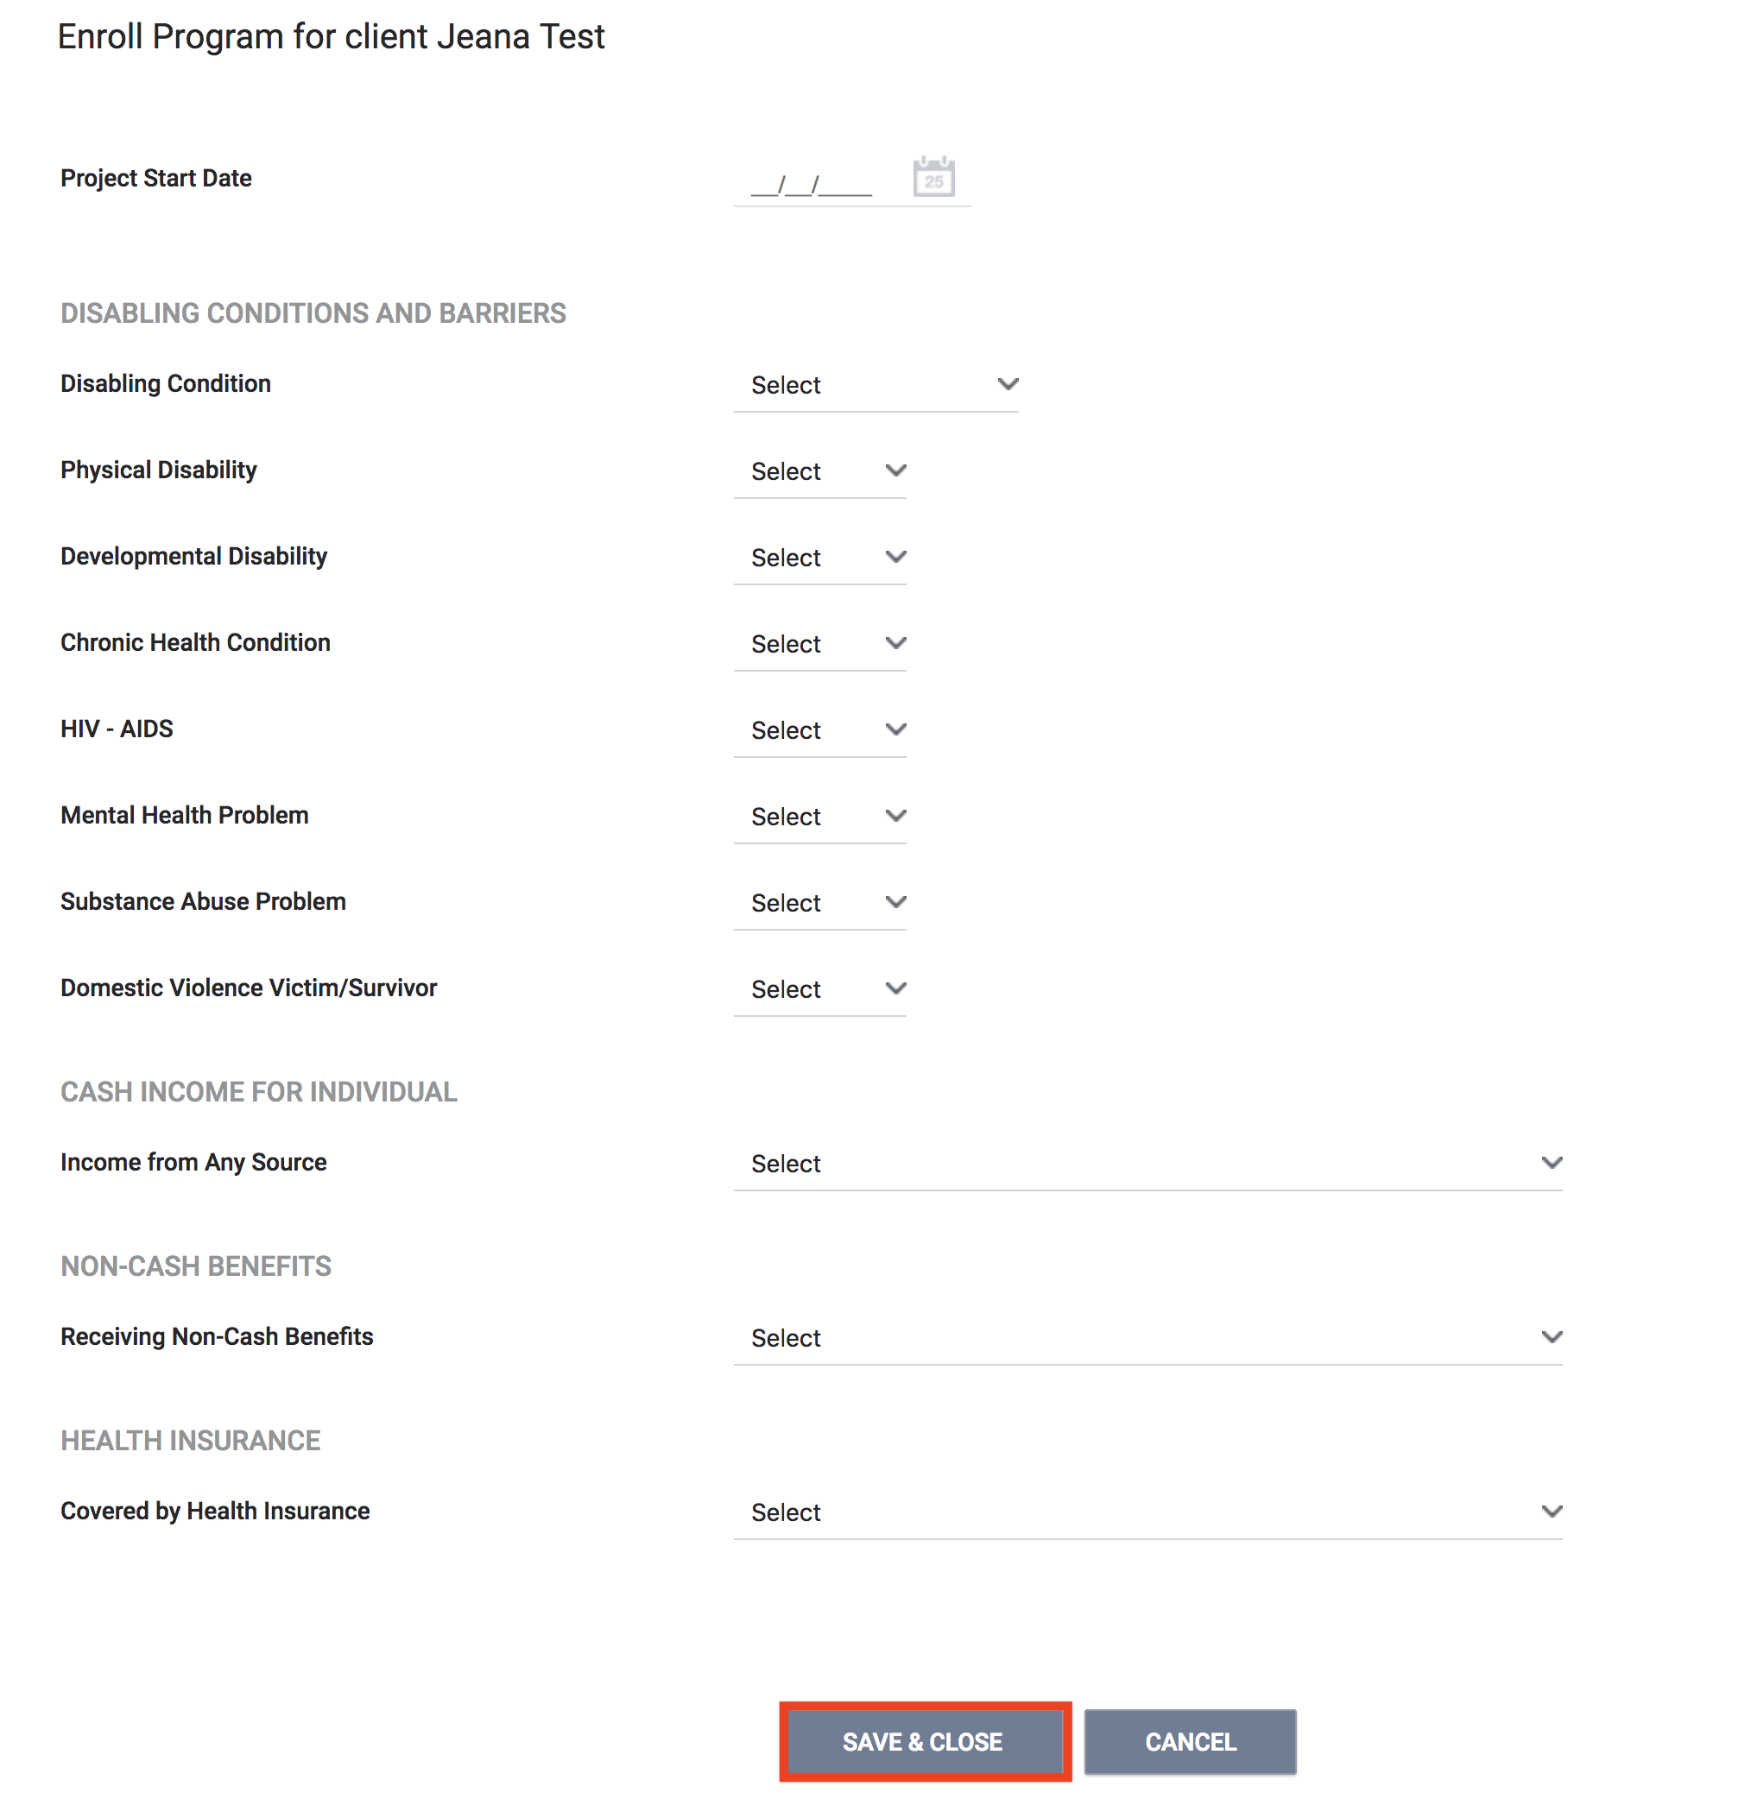
Complete Program Enrollment
Complete the program enrollment questions
Collect as much information from the client as possible
Edit the form and add additional information if collected at a later date

Slide 13
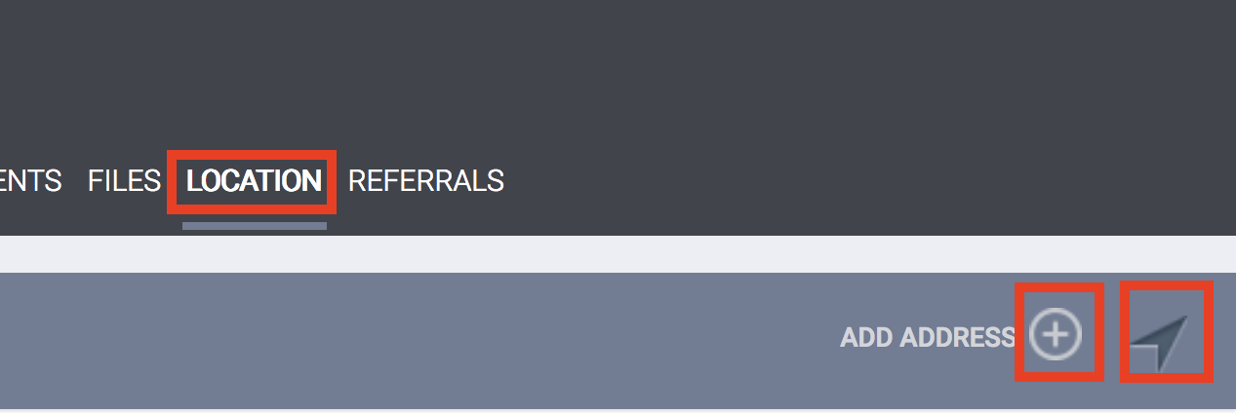

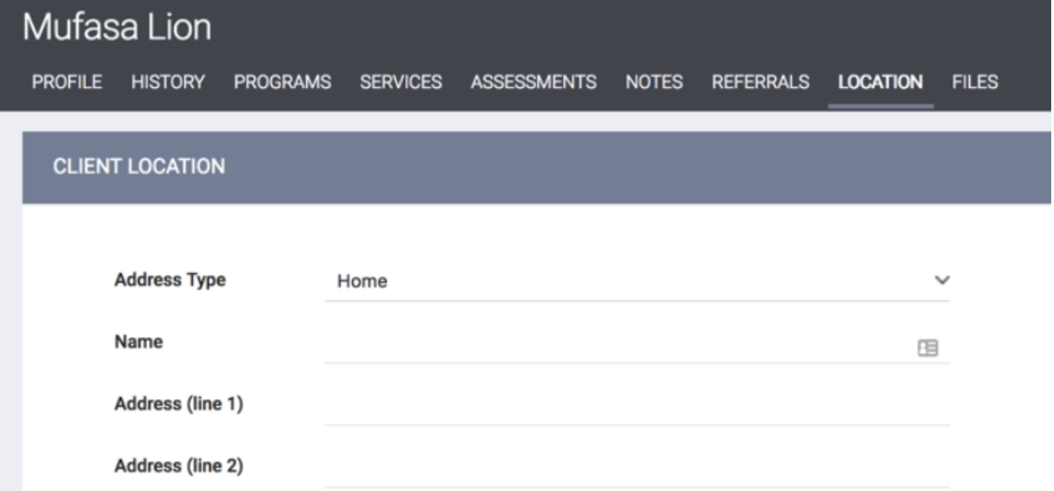

Update the Location Tab
Click on the Location Tab to add details about the client’s location
Allows the address to be entered manually
The arrow will use GPS to enter the exact location you are at when meeting with a client
Use the Location Tab to enter as many locations as needed for a client
Notes:
The Location Tab is used to record a client’s contact information. The Location Tab can be updated multiple times to enter as many locations and phone numbers as possible for a client. Updating the Location Tab is important for anyone trying to locate a client to provide services or housing.
Leave Status toggle on
Never touch the private toggle

Slide 14
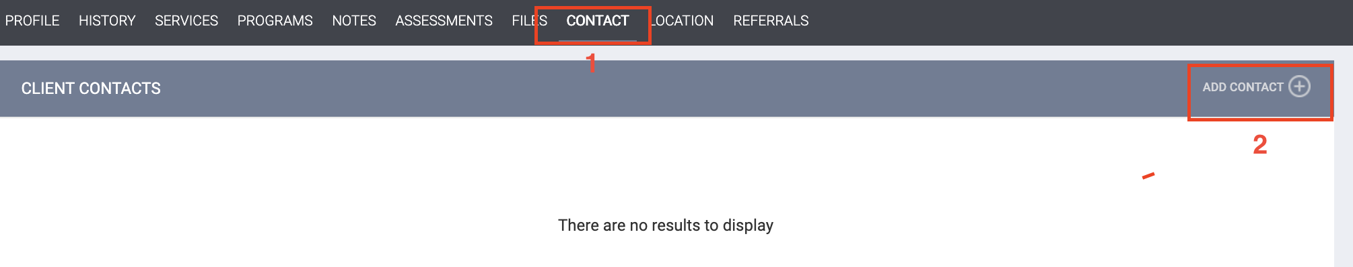
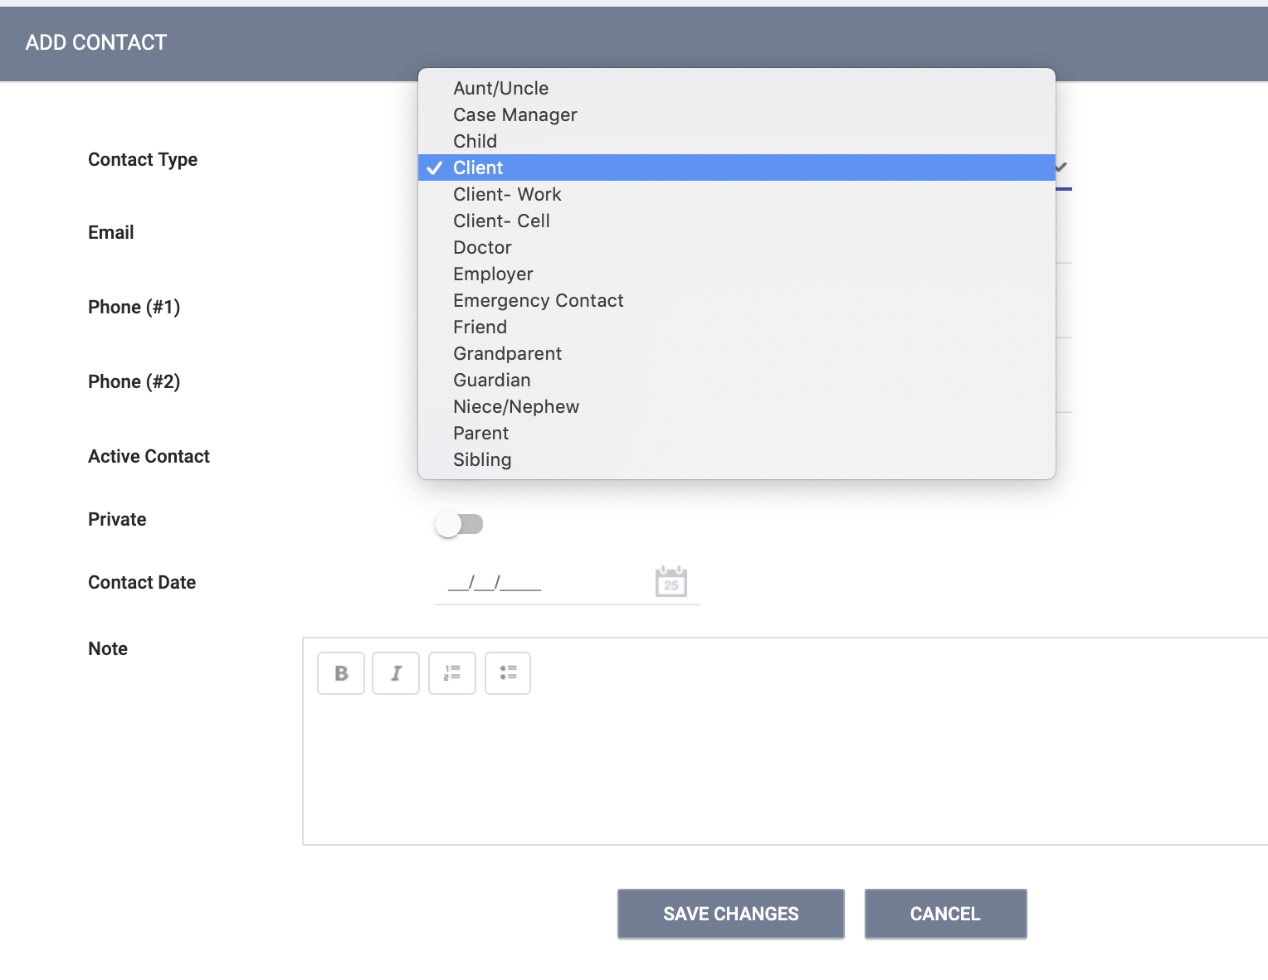
Contact Information
Click the Contact tab
Add contact information for the client or people in their support system (case manager, family member, friend etc.)
Multiple forms of contact can be added
Notes:
New feature

Slide 15
Record an Outreach Service Contact
An outreach contact is…
A contact is defined as an interaction between a worker and a client designed to engage the client. Contacts include activities such as a conversation between the street outreach worker and the client about the client’s well-being or needs, an office visit to discuss their housing plan, or a referral to another community service.

Slide 16
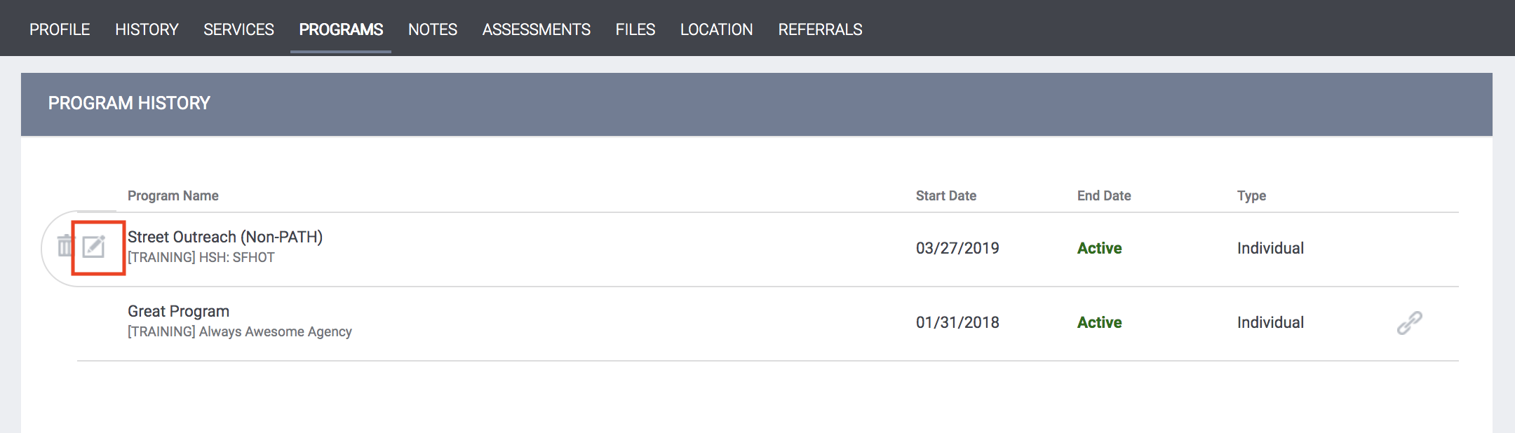
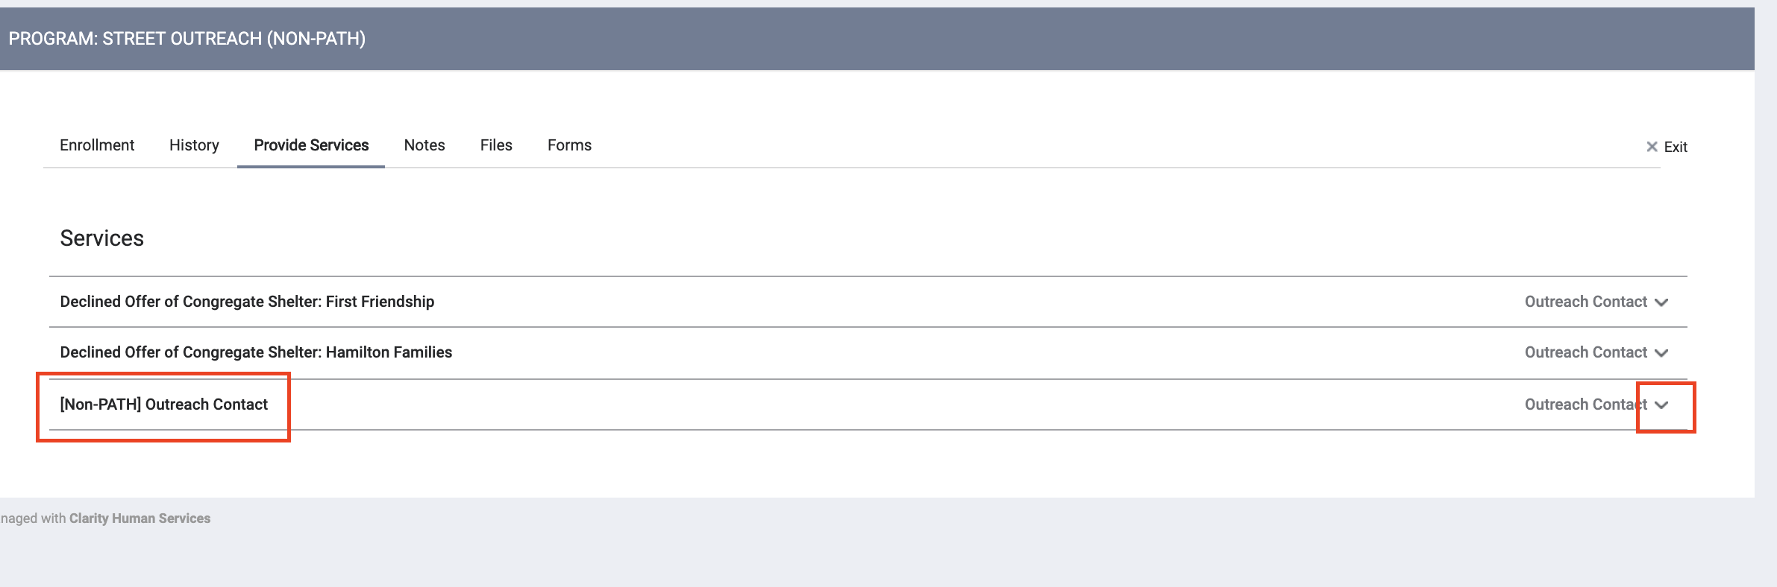
Record an Outreach Service Contact (Continued)
Go to Programs Tab and place mouse to the left of client’s active enrollment in Street Outreach (Non-PATH) (the edit icon will appear)
Click the drop down next to the service provided
Notes should no longer be entered under the notes tab
Notes:
New feature to record services
Leave Status toggle on
Never touch the private toggle

Slide 17
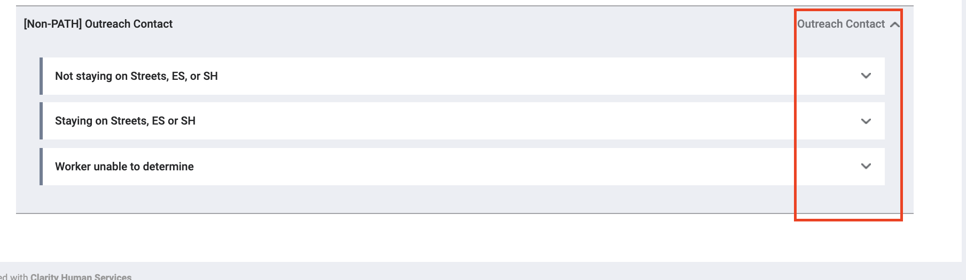
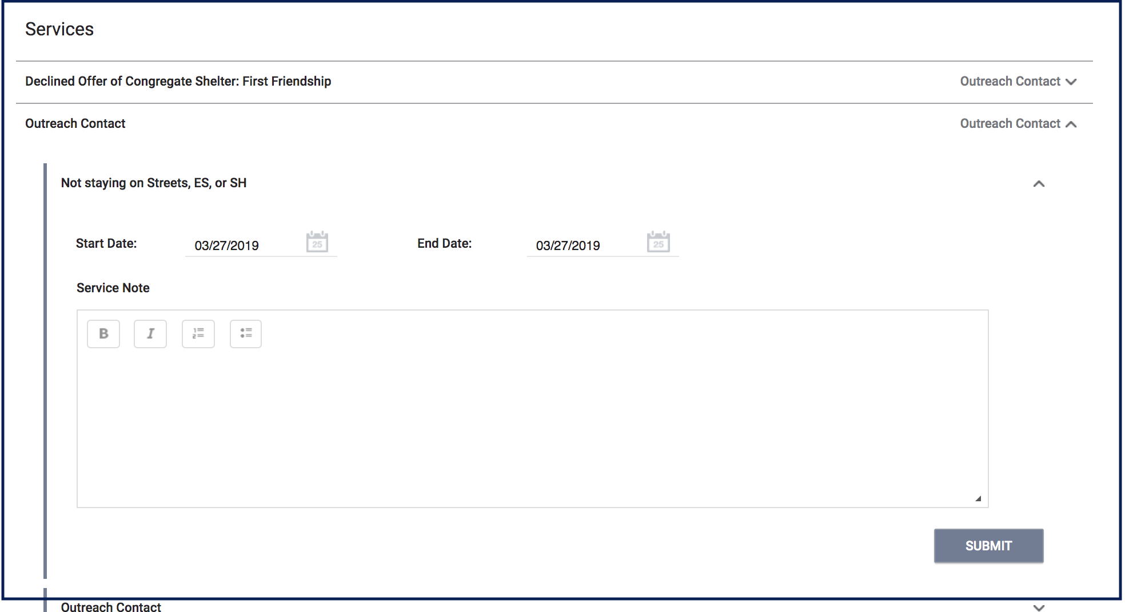
Record an Outreach Service Contact (Continued)
ES= Emergency Shelter
Streets= Sleeping outside
SH= Safe Haven
*Clients are auto-exited if they haven’t had a service in 90 days

Slide 18
Record an Outreach Service Contact (Continued)
Coming Soon....
Two new services to distinguish outreach to encampments
  Street Encampment Outreach
  Vehicle Encampment Outreach
ETA in the the ONE System 08.13.19

Slide 19
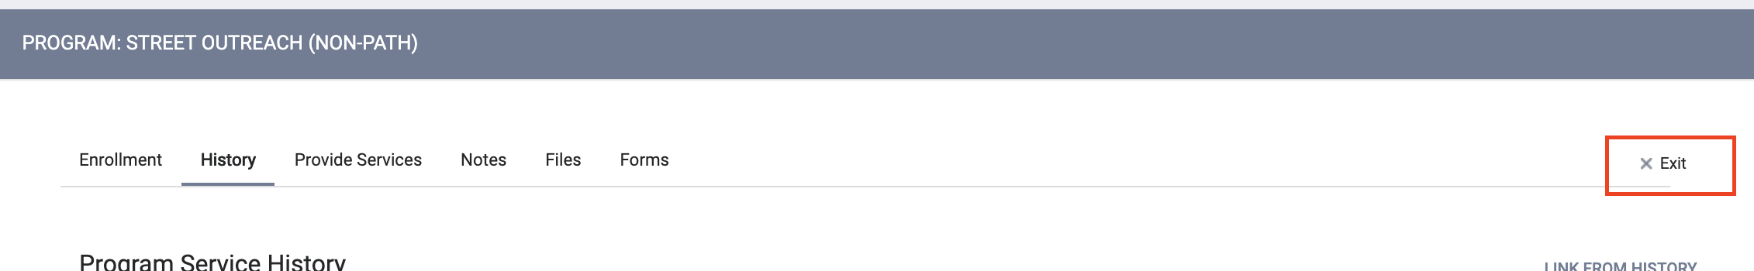
Program Exit
If no service is provided for 90 days, clients are automatically exited (The client’s profile will remain in the ONE System)
Open the program enrollment, click exit.

Slide 20
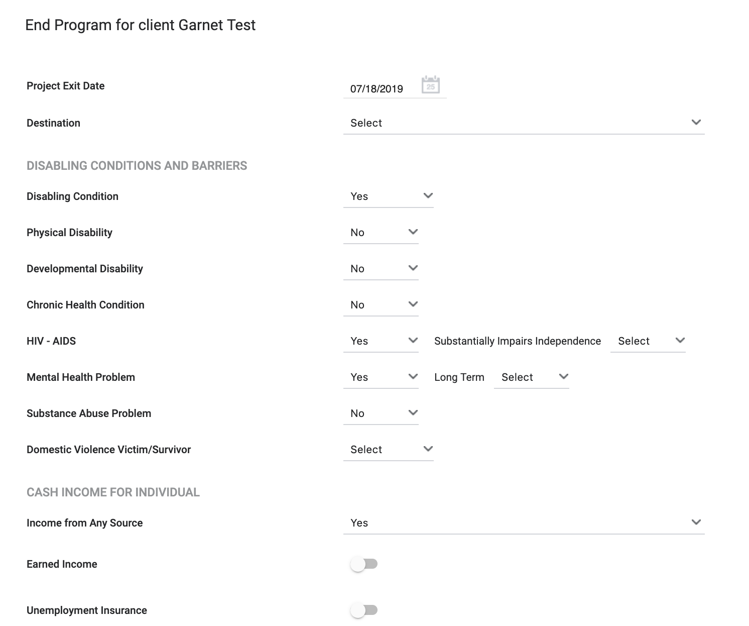
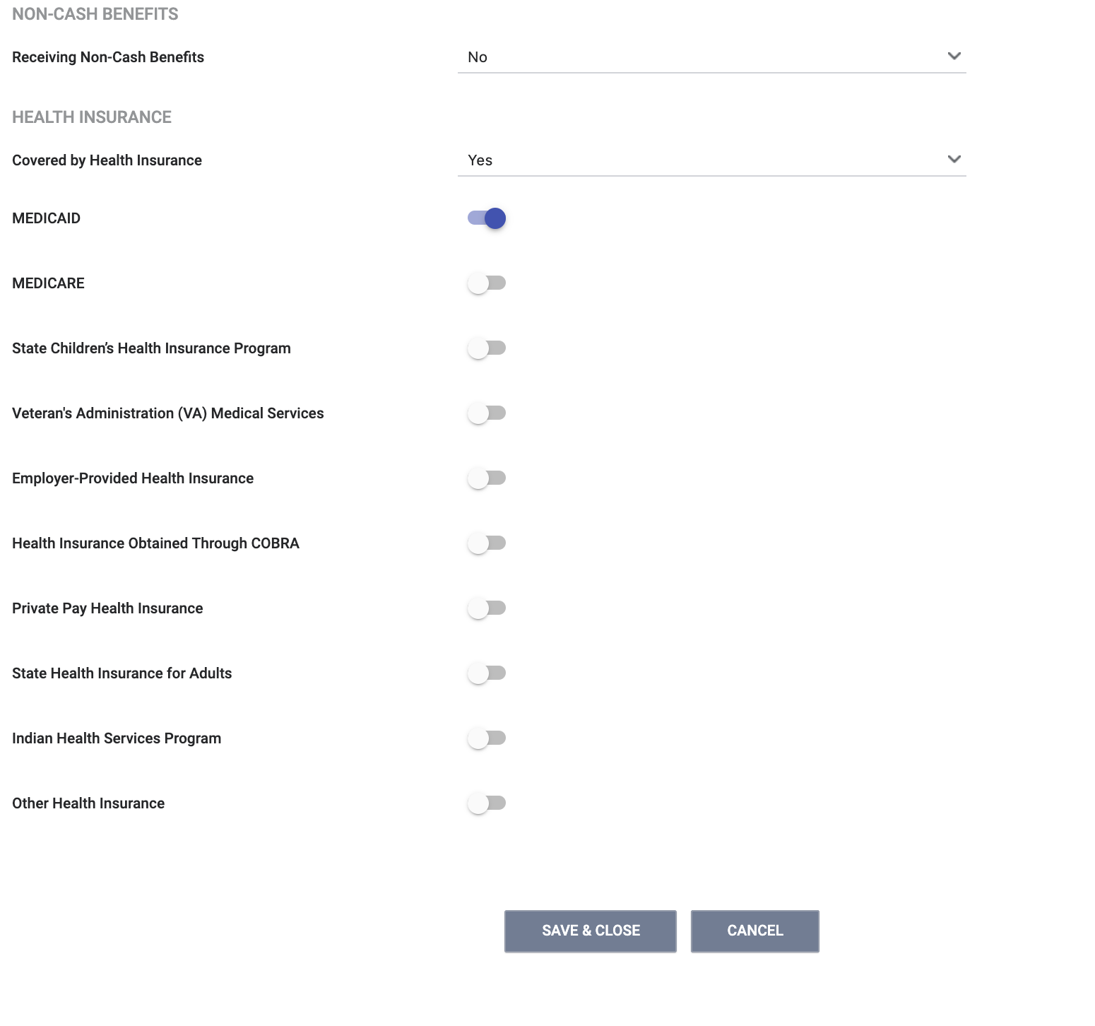
Program Exit
Complete all fields in the exit form and click “Save and Close”

Slide 21
Need More Help?
Supplemental training materials and “How to Guides” https://onesf.clarityhs.help/hc/en-us/articles/360022091313-SFHOT-Training-Materials-
Don’t forget the Helpdesk! onesf@bitfocus.com or 415.429.4211
Notes:
New web page containing CE supplemental training materials

Slide 22
Questions?

